Slide 1
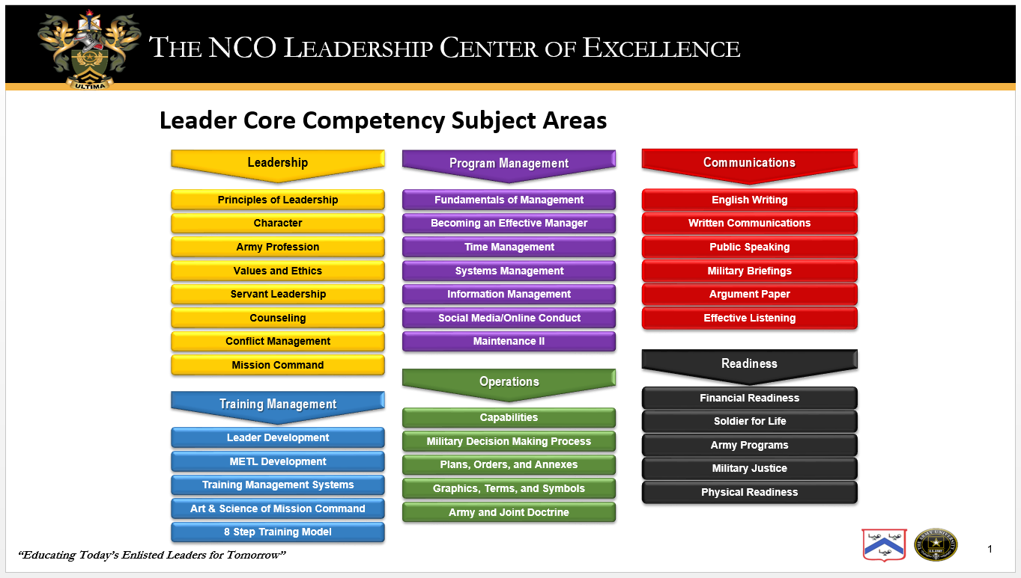


THE NCO LEADERSHIP CENTER OF EXCELLENCE
NCO Common Core Competencies Subject Areas

Slide 2
NCO C3 Definitions
LEADERSHIP: The Army relies on NCOs capable of conducting daily operations, executing mission command, and making intent-driven decisions. NCOs must lead by example and model characteristics of the Army Profession. This competency includes: Leader Development, Counseling, Coaching and Mentoring, the Army Ethic, Army Values, and Character Development. Also includes a thorough understanding of the Leadership Requirements Model, Mission Command Philosophy, Critical Thinking, and Problem Solving.
COMMUNICATIONS: Competent NCOs are effective communicators. NCOs cannot lead, train, counsel, coach, mentor, or build teams without the ability to communicate clearly. This competency includes: Verbal (Public Speaking/Military Briefings) and Written (English and Grammar) communications. Also includes, Active Listening, Facilitation, Negotiations, Social Media, Digital Communications, Media Engagement, Staff Studies, and Decision Papers.
READINESS: NCOs are responsible for Soldier readiness and play a key role in unit readiness. This competency includes: Army Inspections, Command Supply Discipline, Comprehensive Soldier Fitness (physical, spiritual, emotional, social, and family), Equipment Maintenance, Resiliency, MEDPROs, and Financial Readiness.
TRAINING MANAGEMENT: NCOs are directly responsible for training individual Soldiers, crews, and teams. The Army training principles provide a broad, but essential foundation to guide NCO leaders as they plan, prepare, execute, and assess sustained and effective training. This competency includes: Risk Management, Preparing an 8-step outline, Conducting Individual Training, and the Art and Science of training from squad to brigade level (course dependent).
OPERATIONS: Leaders at every echelon are expected to display the initiative necessary to assume prudent risk while taking timely advantage of opportunities that present themselves under ambiguous, chaotic conditions. This competency includes: Large-Scale Combat Operations, Multi-Domain Operations (Cyber, Land, Sea, Air, & Space), Joint Operations, Operational & Mission Variables, Troop Leading Procedures, Military Decision Making Process, Warfighting Functions/Combat Power, Operational Terms & Symbols.
PROGRAM MANAGEMENT: NCOs assist their officer counterparts in managing Army programs that support Soldiers and families. This competency complements readiness and includes: The Army Safety Program, Army Career Tracker (ACT), Human Resource Systems, Military Justice Procedures, the Army Force Management Model (How the Army Runs), Army Community Service (ACS) Programs, and the Soldier for Life-Transition Assistance Program (SFL-TAP).

